Slide 1
Ares’ Robotics Challenge Critical Design Review
By: Bruce Bell, Ryan Wade, Rae Hong, Hiram Saucedo

Slide 2
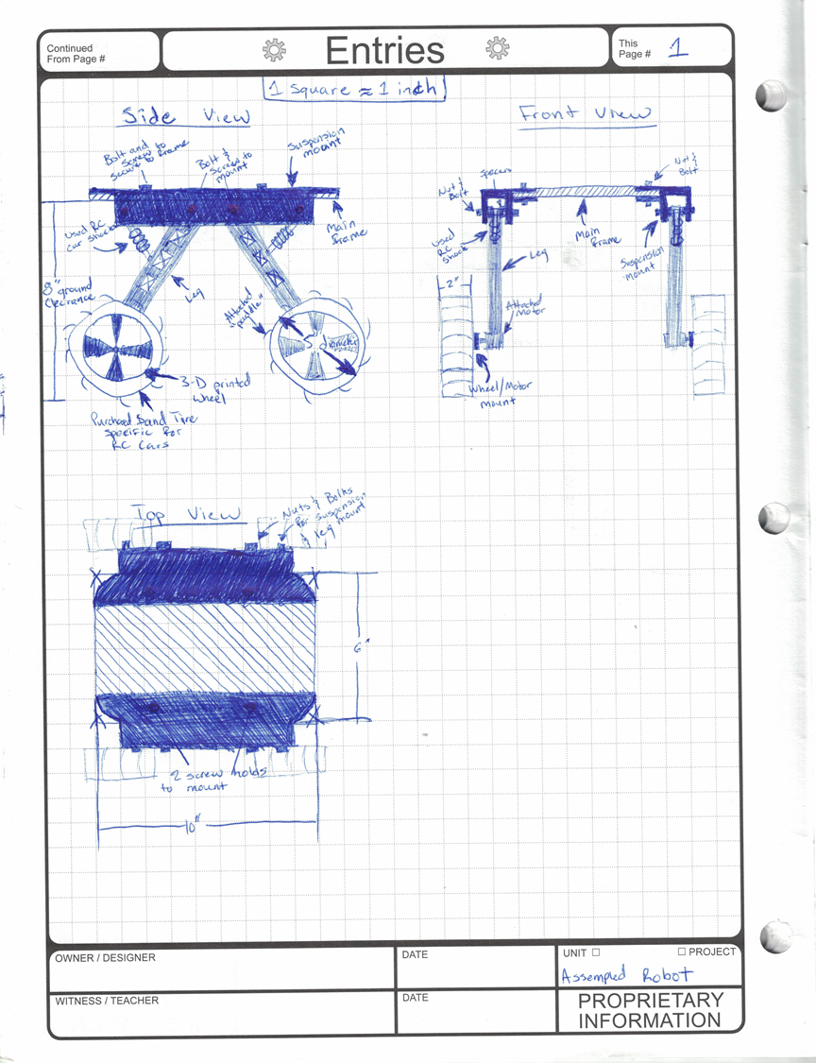
Our basic robot design is for the most part the same as what we originally prototyped. We have made minor changes to the design such as weight, structural additions and other necessary modifications. The printed design is thinner than originally expected in order to meet weight requirements. We have yet to decide a solid roof housing for our electrical components but it will be something light weight and easy such as foam core. We have printed most of our mechanical pieces for the robot and are continuing to assemble.
We have calculated our desired torque and speed and decided that we need a 30RPM motor, which has been ordered and received for all four of them. We have also decided that we are going to use an Ultra Sonic Sensor for the majority of our obstacle recognition. As a back-up we are going to use a Bump Senor. This will help to ensure our robot does not get caught on any obstacles.

Slide 3
Attached to the left is our main chassis design. It is 3D printed with holes to cut the weight down. The holes also allow for easy mounting of our Arduino board and wire organization with zip ties and cable clamps. The high stress areas are thicker to increase durability.
Below is a photo of our first print of the leg design, it is rather large and heavy so it is being sized down. The original leg design could be ran over and not break so the material cut back should not effect strength. The motor, screws and suspension mount fits perfectly into their designated areas.

Slide 4
In the top right corner is a picture of the tires we will use. The paddle design on these tires will provide ease of maneuvering through the lose sand allowing our robot to succeed on its mission. We have a total of 8 of these tires and it is undecided whether we will need or want to double up the tires side by side to create a wider surface area.
In the bottom right corner is a photo of the springs we will use for our suspension. These are easily adjustable by positioning where the set crew sits on the shaft. These springs will mount to the leg and the suspension mount wings which will allow our robot to navigate over pumps and rocks with ease.

Slide 5
Overall Mechanical Components
We have made minor changes to our original design in order to meet budget and weight requirements.
We are continuing to 3D print our robot and test strength and durability as we print.
If weight allows and the robot needs more surface area than we will put two wheels side by side to increase the tire surface area.
A roof design is slowly being designed so we don’t take away time and effort into more important pieces of the robot.
Next on our mechanical component to do list is to fully assemble the chassis and mount sensors and batteries to ensure that the robot is how we envisioned.

Slide 6
Overall Electrical Components
After calculating speed, mass and required torque, we decided that four 30RPM motors would be adequate to drive our robot through the obstacle course.
We are going to use an Ultra Sonic sensor for the majority of our obstacle recognition and as a back up we will have a Bump Sensor mounted to the front for anything that the Ultra Sonic missed.
During the event of an obstacle interference our robot will stop, back up, turn 90 degrees and continue forward following the beacon.
Next on the electrical to do list is to incorporate working functions of sensors and motors to our robot so we can begin the testing and trouble shooting phase.

Slide 7
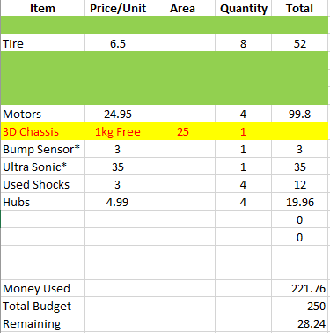
Pricing
Attached is a screen shot of our pricing plan which includes all the items we have already purchased as well as what we anticipate on needing.
We have a bit of room for other parts or unexpected expenses which is a great thing to know incase something goes wrong.

Slide 8
Testing
Once our mechanical design and programing is complete we will first test our robot in the classroom setting to ensure that the basic controls are functioning as they should. Once we fix these issues we will then take it to a larger area with a sand terrain, such as Cherry Creek State park. Here we will not only ensure that the navigation system is working but also that our robot will perform how we want it to in the expected terrain or the sand dunes.

Slide 9
To conclude
We still have a lot of work to do before April 14th but the team is feeling very confident and motivated to continue a steady pass in the production of our robot.
We will continue to assemble our chassis and finalize the mechanical components as well finish the programming to allow our robot to move.
Since we are well within our budget we have one less thing to worry about allowing us to be stress free and put our focus on the main goal, to navigate Mars.

